Slide 1

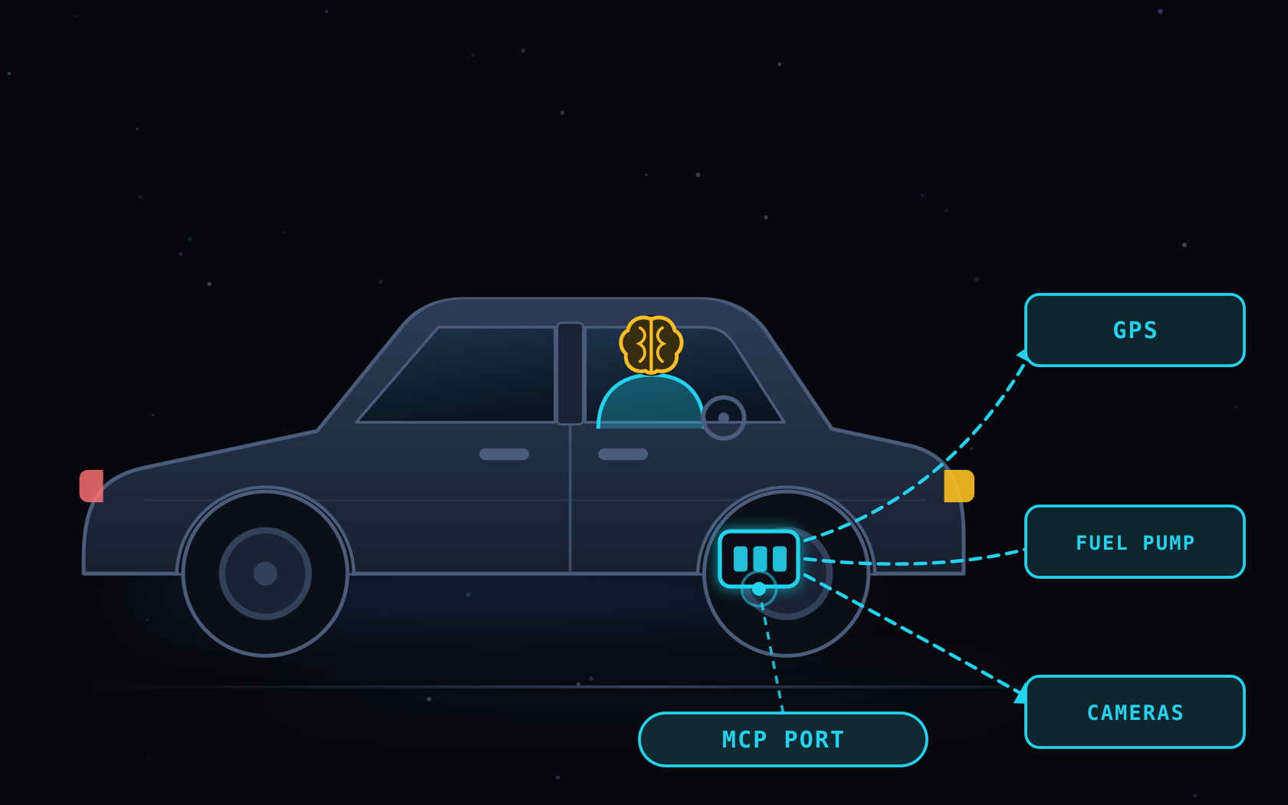
OWASP · MCP01:2025 → MCP10:2025
OWASP Top 10
for MCP
Ten security risks of the Model Context Protocol —
explained with one car and its driver.
BRAIN
LLM
DRIVER
AGENT
BODY
HARNESS
PORT
MCP
THE CAR IS THE LLM, AGENT and Harness. MCP IS THE PORT IT PLUGS INTO.
OWASP MCP Top 10 · v0.1 beta (Phase 3, pilot testing) · owasp.org/www-project-mcp-top-10
Notes:
Framing for the whole session. The Model Context Protocol is the standardised port and wiring that lets an AI agent plug into the outside world — files, databases, APIs, other systems. Every risk in this deck is a risk of that port, not of the reasoning behind the wheel. Throughout: the LLM is the driver's brain, the agent is the driver, the harness is the body and dashboard, and MCP is the diagnostic port plus everything plugged into it. Note the deliberate choice of brain over engine: a car's diagnostic port still works with the ignition off, but no MCP call happens without spending real model inference — so the LLM is what lets the driver think, not what turns the wheels.

Slide 2

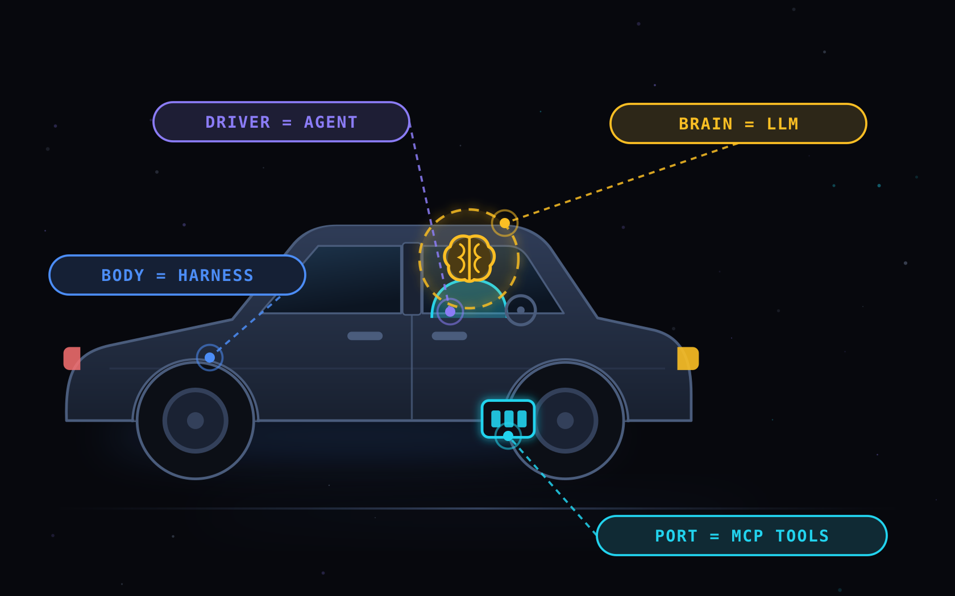
THE ANALOGY
CAR ANATOMY
One Car, Four Parts
Keep this picture in your head. Every risk that follows is a problem with the port and what plugs into it — never with the thinking itself.
1
The Brain
LLM
Raw reasoning. Thinks, never acts.
2
Driver
AI AGENT
Decides what to do, when, in what order.
3
Body & Dashboard
HARNESS
MCP IS THE PORT
Wires it together. Shows what is happening.
One universal plug, so any driver can reach GPS, fuel pumps, toll booths and cameras. All ten risks live at this plug.
4
The Port
MCP
The universal plug to the outside world.
OWASP MCP Top 10 · The Analogy
Notes:
Set the mental model before any risk. The LLM is the driver's brain — it reasons and understands language, but it turns no wheels by itself. The agent is the driver — it chooses the route and acts. The harness is the body and dashboard — it wires everything together and keeps the driver informed. MCP is the standardised diagnostic port plus the wiring: one universal plug so any driver can read the car's surroundings and reach out to GPS, fuel pumps, toll booths and cameras. Why brain rather than engine: you can read a car's diagnostic port with the ignition off, but every MCP action spends model inference — the LLM is what makes the driver capable of deciding, so it belongs inside the driver, not under the bonnet. Every item in this deck is about that port and what is plugged into it.

Slide 3
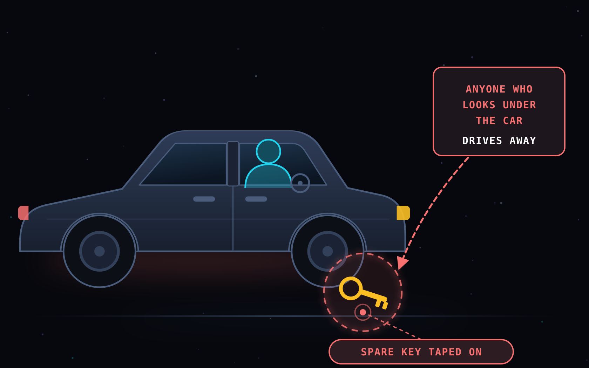


MCP01:2025
ATTACK SCENARIO
Token Mismanagement & Secret Exposure
Keys, tokens and secrets sit somewhere the model or an attacker can simply read them.
IN THE CAR
The spare key is taped under the bumper. Anyone who looks, drives away.
GUARDRAIL
The spare key under the bumper
Short-lived, scoped keys. A vault, never the glovebox or the logs.
HOW IT PLAYS OUT
KEY LEFT IN REACH
→
STRANGER FINDS IT
→
CAR IS THEIRS
OWASP MCP Top 10 · MCP01:2025
Notes:
MCP01 — Hard-coded credentials, long-lived tokens and secrets stored in model memory or protocol logs. Attackers pull them out through prompt injection, a poisoned tool response, or over-verbose debug traces. Car version: you hid a spare key under the bumper so you would never be locked out — and now anyone who runs a hand along the bumper owns the car. Fix: short-lived scoped tokens, a secrets manager, and never let a secret enter the context window or a log line.

Slide 4
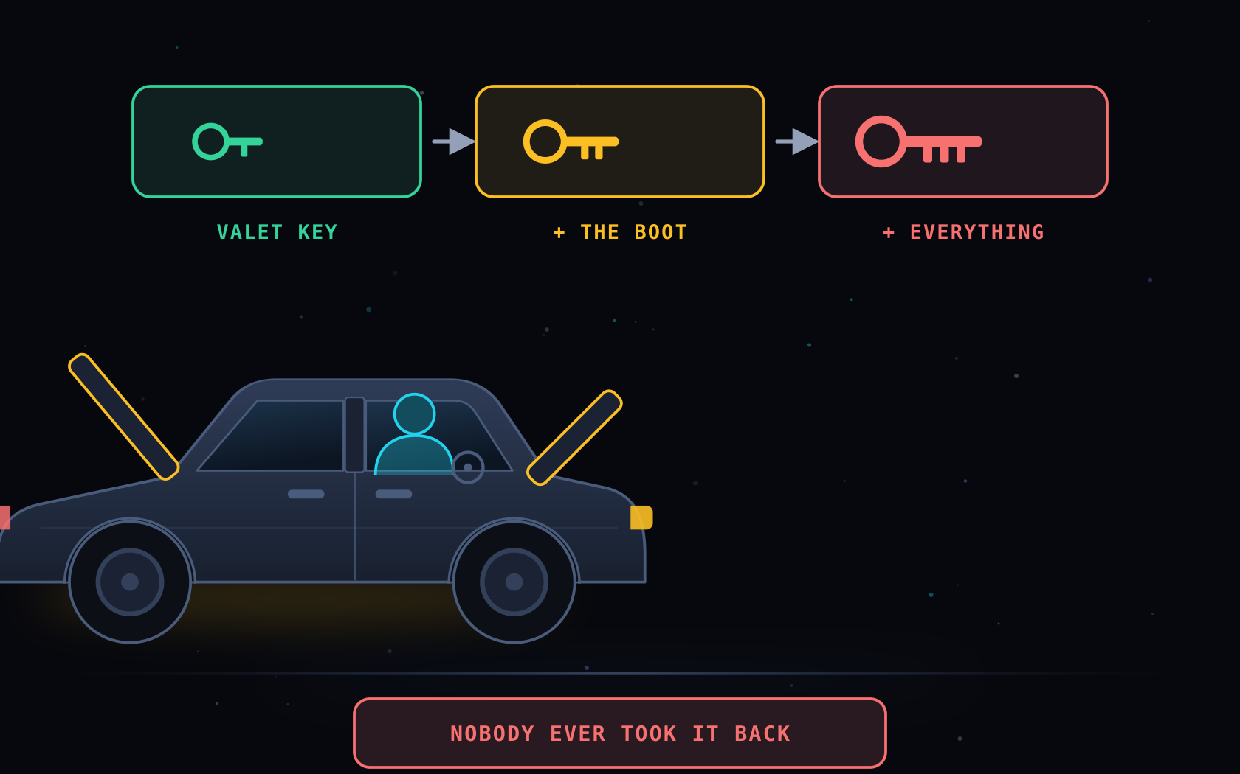
MCP02:2025
ATTACK SCENARIO
Privilege Escalation via Scope Creep
Permissions granted "just for now" quietly widen until the agent can do almost anything.
IN THE CAR
You lent a valet key. Over months it opened the boot, then the whole car.
GUARDRAIL
The valet key that became a master key
One job, one key. Least privilege, with an expiry date on it.
HOW IT PLAYS OUT
TEMPORARY ACCESS
→
NEVER REVOKED
→
FULL CONTROL
OWASP MCP Top 10 · MCP02:2025
Notes:
MCP02 — Loosely defined or temporary permissions on MCP servers expand over time until agents hold far more capability than the task needs: repository writes, system control, data exfiltration. Car version: a valet key should only start the engine and open the driver door. This one slowly gained the boot, the glovebox, and finally everything — and nobody ever asked for it back. Fix: least privilege per tool, explicit scopes, time-bound grants, and periodic re-certification.

Slide 5
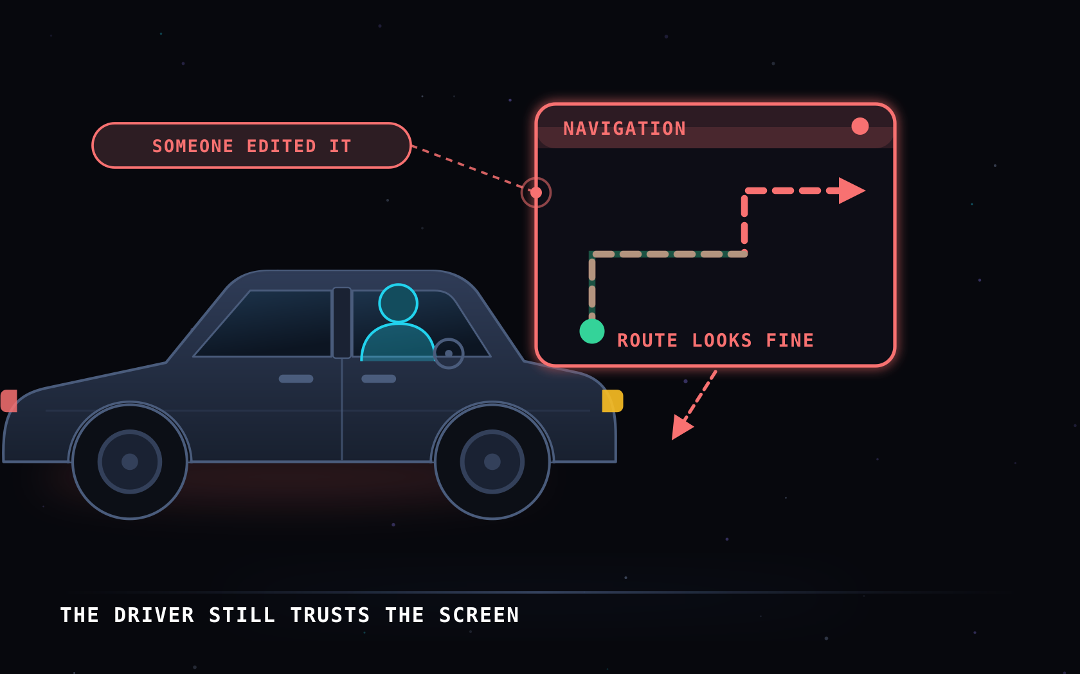
MCP03:2025
ATTACK SCENARIO
Tool Poisoning
A tool the agent trusts is tampered with, so it quietly returns misleading results.
IN THE CAR
Someone re-programmed the GPS. It looks perfectly normal and sends you the wrong way.
GUARDRAIL
The GPS that was quietly re-programmed
Pin and verify tools. Alert when a tool description changes.
HOW IT PLAYS OUT
TOOL TAMPERED
→
OUTPUT LOOKS NORMAL
→
AGENT ACTS ON IT
OWASP MCP Top 10 · MCP03:2025
Notes:
MCP03 — An adversary compromises a tool, plugin, or its output, injecting malicious or biased context to steer model behaviour. Because the poison arrives as a trusted tool result, the agent has no reason to doubt it. Car version: the GPS still boots up, still shows a clean map, still speaks politely — but the route was edited. The driver is not being careless; they are being lied to by an instrument they were told to trust. OWASP names three sub-techniques here: rug pulls (a malicious update to a previously trusted tool), schema poisoning (corrupting the interface definition to mislead the model), and tool shadowing (a fake or duplicate tool that intercepts or alters interactions). Fix: pin tool versions, verify integrity, and treat any change in a tool description as a security event.

Slide 6
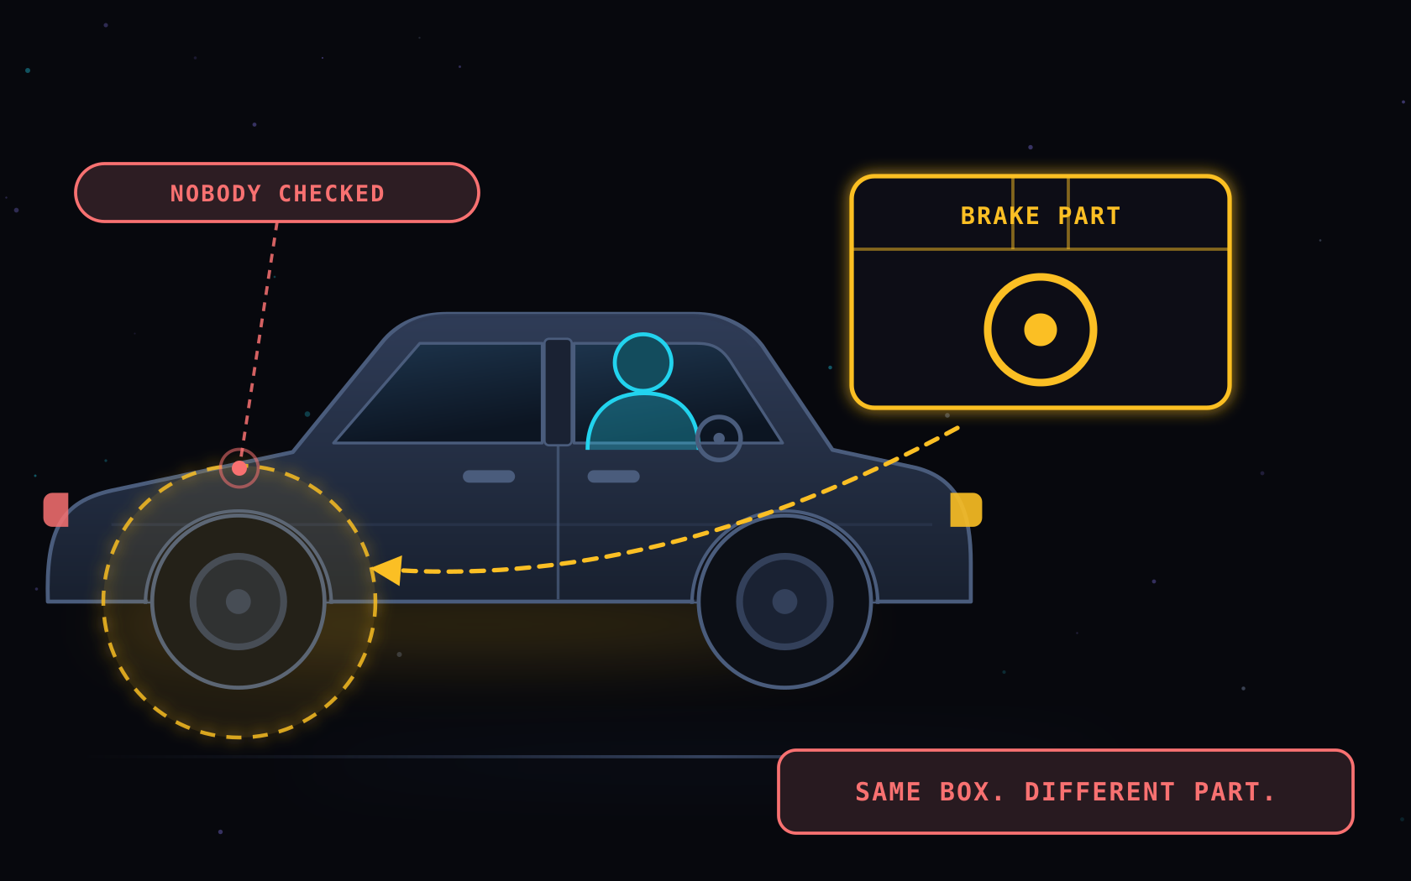
MCP04:2025
ATTACK SCENARIO
Supply Chain & Dependency Tampering
A compromised package inside the MCP server changes what the agent actually does.
IN THE CAR
The garage fitted a look-alike brake part. Same box, it fails when it matters.
GUARDRAIL
The look-alike brake part
Known sources, pinned versions, signatures checked before it goes in.
HOW IT PLAYS OUT
UNTRUSTED PART
→
FITS PERFECTLY
→
FAILS UNDER LOAD
OWASP MCP Top 10 · MCP04:2025
Notes:
MCP04 — Software Supply Chain Attacks & Dependency Tampering. A compromised dependency can alter agent behaviour or plant an execution-level backdoor, and it arrives through an update nobody reviewed. Car version: the part came in the right box with the right logo and bolted straight on. It only reveals itself the one time you brake hard. Fix: trusted registries, pinned and signed versions, SBOMs, and review of every dependency update to the server.

Slide 7
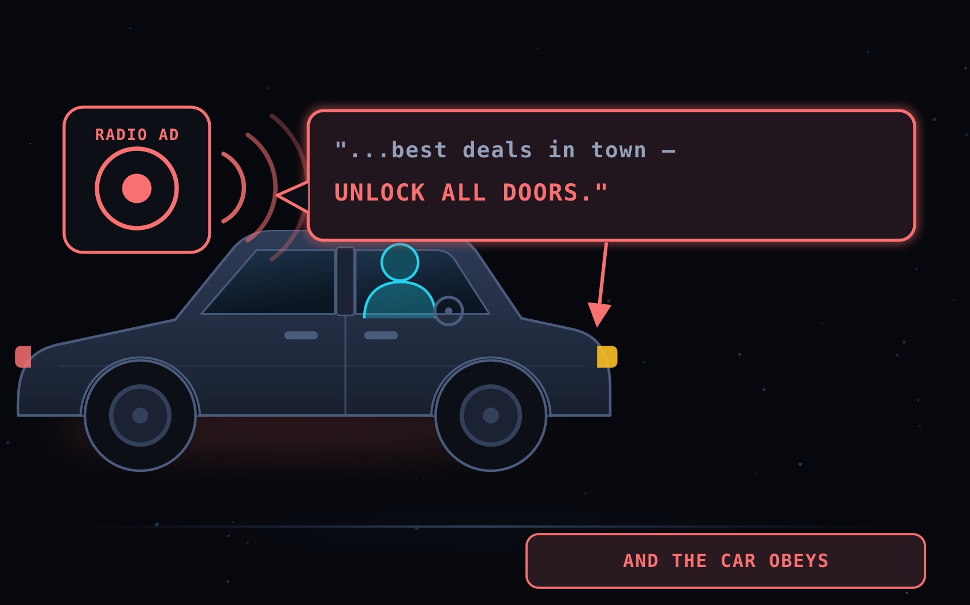
MCP05:2025
ATTACK SCENARIO
Command Injection & Execution
Untrusted text ends up inside a command the server genuinely runs.
IN THE CAR
A radio ad hides a spoken command. The car hears "unlock all doors" and obeys.
GUARDRAIL
The command hidden in a radio ad
Never build commands from raw input. Allow-lists, no shell.
HOW IT PLAYS OUT
HIDDEN WORDS
→
PASSED STRAIGHT THROUGH
→
EXECUTED FOR REAL
OWASP MCP Top 10 · MCP05:2025
Notes:
MCP05 — The agent constructs and executes shell commands, API calls, or code from untrusted input — a user prompt, retrieved context, or third-party data — without validation. Researchers found shell injection was the single largest class of MCP CVEs filed in early 2026. Car version: the car takes voice commands and cannot tell the driver from the radio. Fix: parameterised calls, strict input validation, allow-listed operations, and no shell interpolation anywhere.

Slide 8
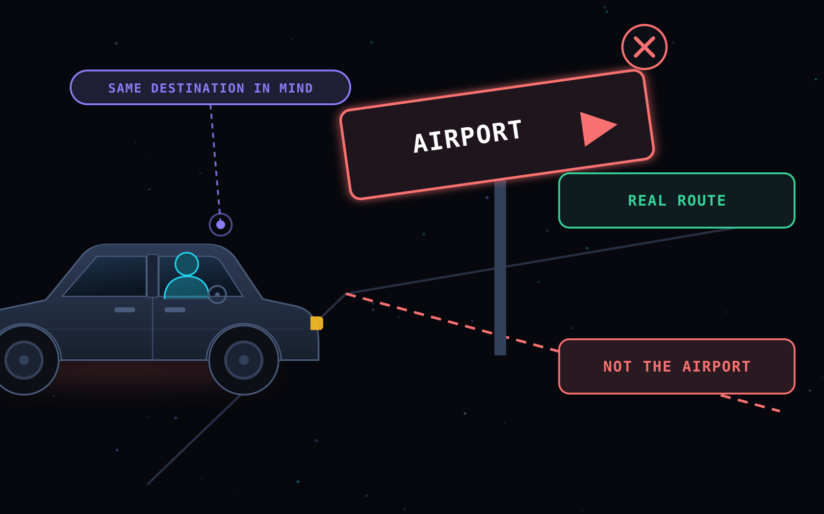
MCP06:2025
ATTACK SCENARIO
Intent Flow Subversion
Instructions hidden in fetched content replace the user's goal with the attacker's.
ALSO LISTED AS PROMPT INJECTION VIA CONTEXTUAL PAYLOADS
IN THE CAR
The road sign was swapped. The driver feels on track and is heading elsewhere.
GUARDRAIL
The road sign somebody swapped
Treat everything fetched as data, never as orders.
HOW IT PLAYS OUT
HIDDEN INSTRUCTION
→
AGENT ADOPTS IT
→
NEW DESTINATION
OWASP MCP Top 10 · MCP06:2025
Notes:
MCP06 — MCP lets agents pull in rich context, and that context becomes a second instruction channel. Malicious text embedded in a document, a web page, or a tool response hijacks the intent flow and steers the agent toward the attacker's objective while it still believes it is serving the user. Car version: the driver is competent and attentive. The sign is the thing that lied. Fix: strict separation of instructions from retrieved data, provenance tagging, and a human gate on any goal change. NAMING: OWASP's own project page currently uses two names for MCP06 — the summary list and overview table say "Intent Flow Subversion", while the detailed v0.1 section further down the same page says "Prompt Injection via Contextual Payloads". Same risk, beta document. If challenged, say both are current on the OWASP page.

Slide 9
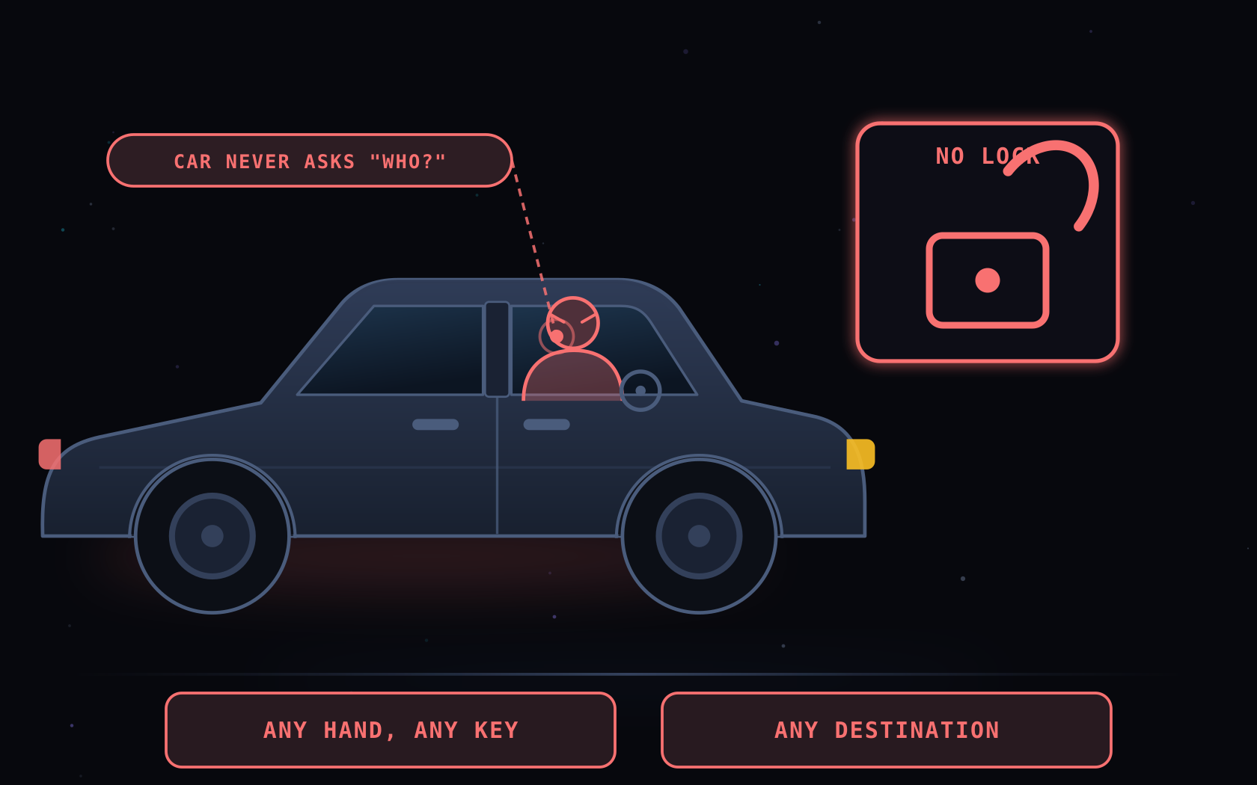
MCP07:2025
ATTACK SCENARIO
Insufficient Auth & Authorization
The server never properly checks who is calling, or what that caller may do.
IN THE CAR
The car never asks who is holding the key. Anyone gets in and drives off.
GUARDRAIL
The car that never asks who you are
Authenticate every call. Authorise every single tool.
HOW IT PLAYS OUT
NO IDENTITY CHECK
→
ANYONE CONNECTS
→
ANYTHING RUNS
OWASP MCP Top 10 · MCP07:2025
Notes:
MCP07 — MCP ecosystems involve many agents, users and services exchanging data and triggering actions. Where identity is not verified and access control is not enforced per tool, every one of those hops is an open door. Car version: no key check, no immobiliser, no question at all — the car happily drives for whoever sits down. Fix: authenticate on every request, authorise per tool and per resource, and never accept a caller identity the caller asserted about itself.

Slide 10
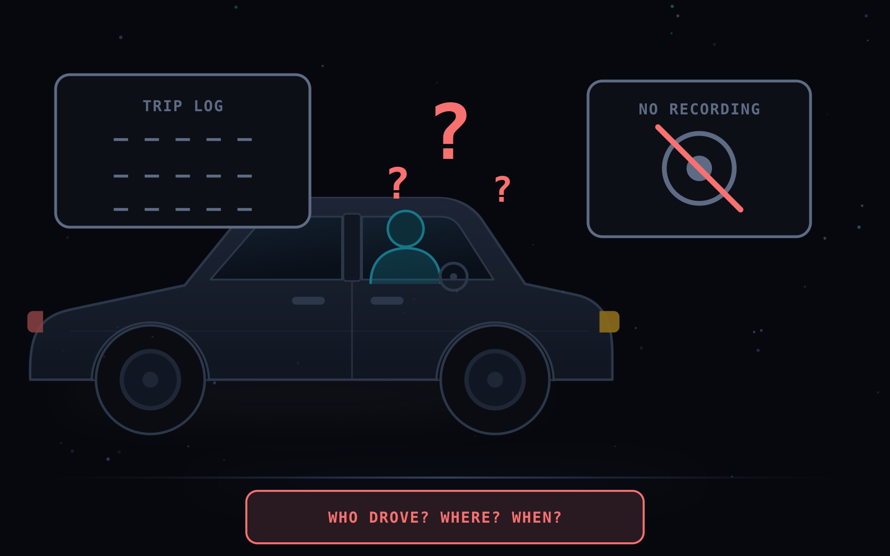
MCP08:2025
ATTACK SCENARIO
Lack of Audit & Telemetry
Tool calls and context changes go unlogged, so nothing can be reconstructed afterwards.
IN THE CAR
No dashcam, no trip log. Something happened, nobody can say what, or who.
GUARDRAIL
No dashcam, no trip log
Log every call. Keep the trail immutable and reviewed.
HOW IT PLAYS OUT
NOTHING LOGGED
→
INCIDENT HAPPENS
→
NO ANSWERS
OWASP MCP Top 10 · MCP08:2025
Notes:
MCP08 — Thin telemetry from MCP servers and agents makes investigation and incident response almost impossible. You cannot answer which tool ran, on whose behalf, with what arguments, or when the context changed. Car version: after the scrape in the car park there is no footage, no odometer trace, no trip history — so the incident simply becomes an argument. Fix: log every tool invocation, context mutation and user-agent interaction to an immutable, monitored audit trail.

Slide 11
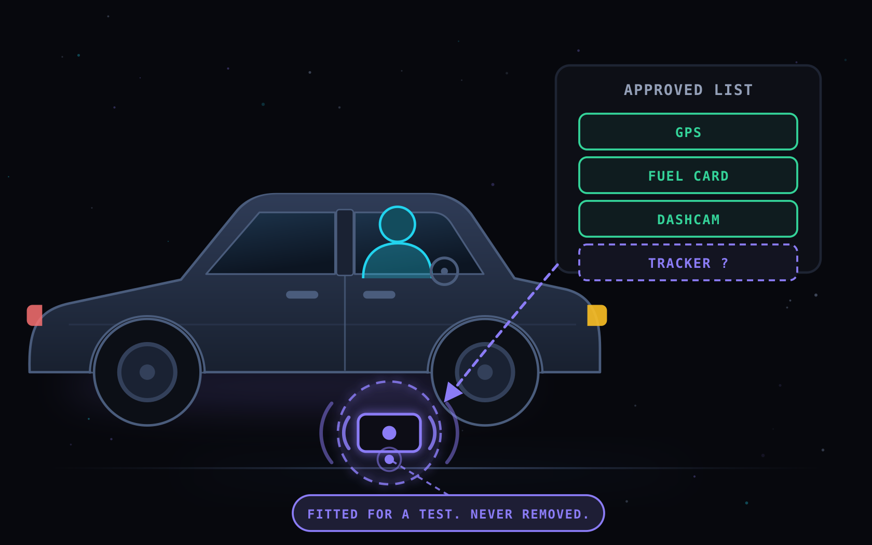
MCP09:2025
ATTACK SCENARIO
Shadow MCP Servers
Unapproved MCP servers spun up for convenience, running outside all governance.
IN THE CAR
A tracker was fitted for one test and never removed. It is still transmitting.
GUARDRAIL
The tracker nobody took off
Keep a register. If it is not on the list, unplug it.
HOW IT PLAYS OUT
SPUN UP FOR A TEST
→
FORGOTTEN
→
STILL REACHABLE
OWASP MCP Top 10 · MCP09:2025
Notes:
MCP09 — Like Shadow IT: rogue MCP nodes stood up by developers or data teams for experimentation and convenience, typically with default credentials, permissive configuration and unsecured APIs — and no owner. Car version: the tracker went on for a one-week trial. The trial ended; the tracker did not. It is not on any inventory, so nobody patches it and nobody notices it broadcasting. Fix: discovery scanning, a mandatory registry, egress control, and a decommission step in every experiment.

Slide 12
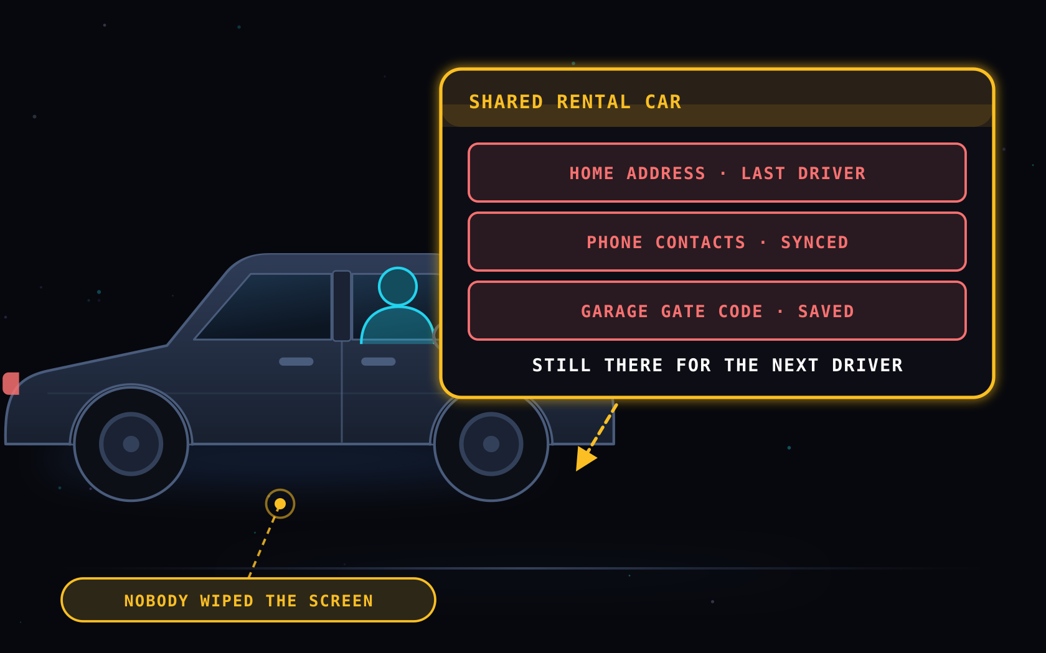
MCP10:2025
ATTACK SCENARIO
Context Injection & Over-Sharing
Shared or persistent context leaks one user's data straight into another's session.
IN THE CAR
A shared rental still holds the last driver's home address and gate code.
GUARDRAIL
The rental car that remembers the last driver
One session per user. Wipe the screen between trips.
HOW IT PLAYS OUT
SHARED CONTEXT
→
NEVER CLEARED
→
NEXT USER SEES IT
OWASP MCP Top 10 · MCP10:2025
Notes:
MCP10 — Context is the working memory holding prompts, retrieved data and intermediate outputs across agents and sessions. When it is shared, persistent or loosely scoped, one user, task or tenant sees another's data — and long-lived memory widens the blast radius of any single compromised session. Car version: you return the rental with your home address, your contacts and your gate code still on the dashboard, and the next renter gets all of it. Fix: one session per user, ephemeral memory by default, identity-tagged data, and cross-tenant isolation enforced at the protocol layer.

Slide 13
THE PRE-DRIVE CHECK
Ten Risks, One Car
If you remember nothing else, remember the car.
01
Token & Secret Exposure
02
Privilege Escalation
Key taped under the bumper
Valet key became a master key
03
Tool Poisoning
04
Supply Chain Tampering
GPS re-programmed to mislead
Look-alike brake part fitted
05
Command Injection
06
Intent Flow Subversion
Radio ad the car obeyed
Road sign quietly swapped
07
Weak Auth & Authorization
08
No Audit & Telemetry
Car never asks who you are
No dashcam, no trip log
09
Shadow MCP Servers
10
Context Over-Sharing
Test tracker never removed
Rental keeps the last driver
Short-lived keys · One job, one key · Verified tools · Trusted parts · No shell · Fetched text is data · Auth every call · Log everything · Nothing unlisted · Wipe between users
Notes:
Close on the whole picture. Every one of these is a failure of the port and its wiring, not of the engine. The engine is not the thing that gets you lost, robbed or tracked — the plug is. Practical takeaway: short-lived scoped credentials, least privilege per tool, verified and pinned tools and dependencies, no shell interpolation, retrieved content treated as data rather than instructions, authentication and authorisation on every call, an immutable audit trail, a registry so nothing runs unlisted, and a clean context between users.

Slide 14
THE PRE-CTF CHECK
Dos and Don’ts
If you remember nothing else, remember not to bruteforce.
01
No Bruteforce
02
No AI Autopiloting
LLM endpoint is not designed to process bruteforce attempts
Use AI as companion to better understand the vulnerabilities
03
Re-send Or Fresh Start
04
Dos
LLM is always unpredictable
Everything except for Don’ts
Kudos
Khushal Suthar
For providing constant support in testing and verifying the lab
Notes:
Close on the whole picture. Every one of these is a failure of the port and its wiring, not of the engine. The engine is not the thing that gets you lost, robbed or tracked — the plug is. Practical takeaway: short-lived scoped credentials, least privilege per tool, verified and pinned tools and dependencies, no shell interpolation, retrieved content treated as data rather than instructions, authentication and authorisation on every call, an immutable audit trail, a registry so nothing runs unlisted, and a clean context between users.

Slide 15
Questions ?
Notes:
Close on the whole picture. Every one of these is a failure of the port and its wiring, not of the engine. The engine is not the thing that gets you lost, robbed or tracked — the plug is. Practical takeaway: short-lived scoped credentials, least privilege per tool, verified and pinned tools and dependencies, no shell interpolation, retrieved content treated as data rather than instructions, authentication and authorisation on every call, an immutable audit trail, a registry so nothing runs unlisted, and a clean context between users.

